Slide 1
Built-in Directives in Angular
I.SHINY PAUL
22H51A0528
CSE-D

Slide 2
Built-in directives in Angular
Directives are markers in the Document Object Model(DOM). Directives can be used with any controller or HTML tag which will tell the compiler what exact operation or behavior is expected. There are some directives present that are predefined but if a developer wants he can create new directives (custom-directive).
There are basically 3 types of directives and each type has some built-in directives
1. Component Directives
2. Attribute Directives
3. Structural Directives

Slide 3
1. Component Directives
Components are directives with templates. They are the building blocks of Angular applications, encapsulating both the UI (User Interface) and the behavior of a part of the application. Components are used to create reusable and modular UI elements. They are declared using the @Component decorator and typically have a corresponding HTML template.
Syntax: In the component below, we have used the @Component here to define a component.
Ex:
import { Component } from '@angular/core'; @Component({ selector: 'app-root', templateUrl: './app.component.html', }) export class AppComponent {}

Slide 4
2. Attribute Directives
Attribute directives are used to change the appearance or behavior of a DOM element by applying custom attributes. These directives are applied to elements as attributes and are denoted by square brackets. Attribute directives are often used for tasks such as dynamic styling, input validation, or DOM manipulation.
Built-in Attribute Directives:
ngClass : The NgClass directive allows us to conditionally apply CSS classes to HTML elements.
Syntax:
<div [ngClass]="{'class-name': condition}"> <!-- Content here --> </div>

Slide 5
2. ngStyle: The NgStyle directive enables you to conditionally apply inline styles to HTML elements.
Syntax:
<div [ngStyle]="{'property': 'value'}"> <!-- Content here --> </div>
3. ngModel: The NgModel directive provides two-way data binding for form elements, syncing data between the model and the view.
Syntax:
<input [(ngModel)]="property">

Slide 6
CODE:
<!-- app.component.html -->
<div class="container">
<h1 class="title">GeeksforGeeks</h1>
<div class="content">
<div [ngClass]="{'highlight': isHighlighted, 'italic': isItalic}">
This div's classes are dynamically applied based on conditions.
</div>
<div [ngStyle]="{'color': textColor, 'font-size': fontSize + 'px'}">
This div's styles are dynamically applied based on properties.
</div>
<input type="text" [(ngModel)]="username" class="input-field">
<p class="greeting">Hello, {{ username }}!</p>
</div>
</div>

Slide 7
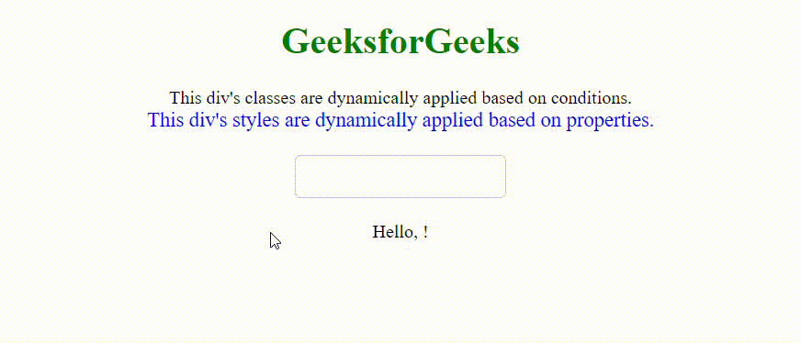
OUTPUT

Slide 8
3. Structural Directives
Structural directives are responsible for manipulating the DOM layout by adding, removing, or manipulating elements based on conditions. They are denoted by an asterisk (*) preceding the directive name and are commonly used to alter the structure of the DOM based on conditions. Examples include , , and ngSwitch.
Built-in Attribute Directives:
1. ngIf: The ngIf directive conditionally includes or removes an element based on a provided expression.
Syntax:
<element *ngIf="condition"> <!-- Content to display when condition is true --> </element>

Slide 9
2. ngFor: The ngFor directive iterates over a collection and instantiates a template once for each item in the collection.
Syntax: <element *ngFor="let item of items"> <!-- Content to repeat for each item --> </element>
3. ngSwitch: The ngSwitch directive is similar to a switch statement in programming languages. It displays one element from a set of elements based on a provided expression.
Syntax: <element [ngSwitch]="expression"> <element *ngSwitchCase="value1"> <!-- Content for case 1 --> </element> <element *ngSwitchCase="value2"> <!-- Content for case 2 --> </element> <!-- More ngSwitchCase elements for other cases --> <element *ngSwitchDefault> <!-- Default content --> </element> </element>

Slide 10
CODE: <!-- app.component.html -->
<div class="container">
<h1 class="title">GeeksforGeeks</h1>
<div class="content">
<div *ngIf="isLoggedIn" class="message">
Welcome to {{ username }}!
</div>
<ul *ngIf="items.length > 0" class="list">
<li *ngFor="let item of items" class="list-item">
{{ item }}
</li>
</ul>
<div [ngSwitch]="color" class="color-switch">
<p *ngSwitchCase="'red'" class="color-message">Red color selected</p>
<p *ngSwitchCase="'blue'" class="color-message">Blue color selected</p>
<p *ngSwitchCase="'green'" class="color-message">Green color selected</p>
<p *ngSwitchDefault class="color-message">Please select a color</p>
</div>
</div>
</div>

Slide 11
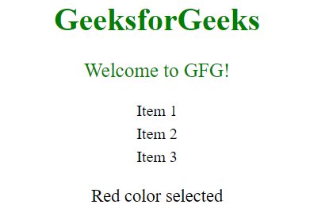
OUTPUT:

Slide 12
THANK YOU

